Slide 1
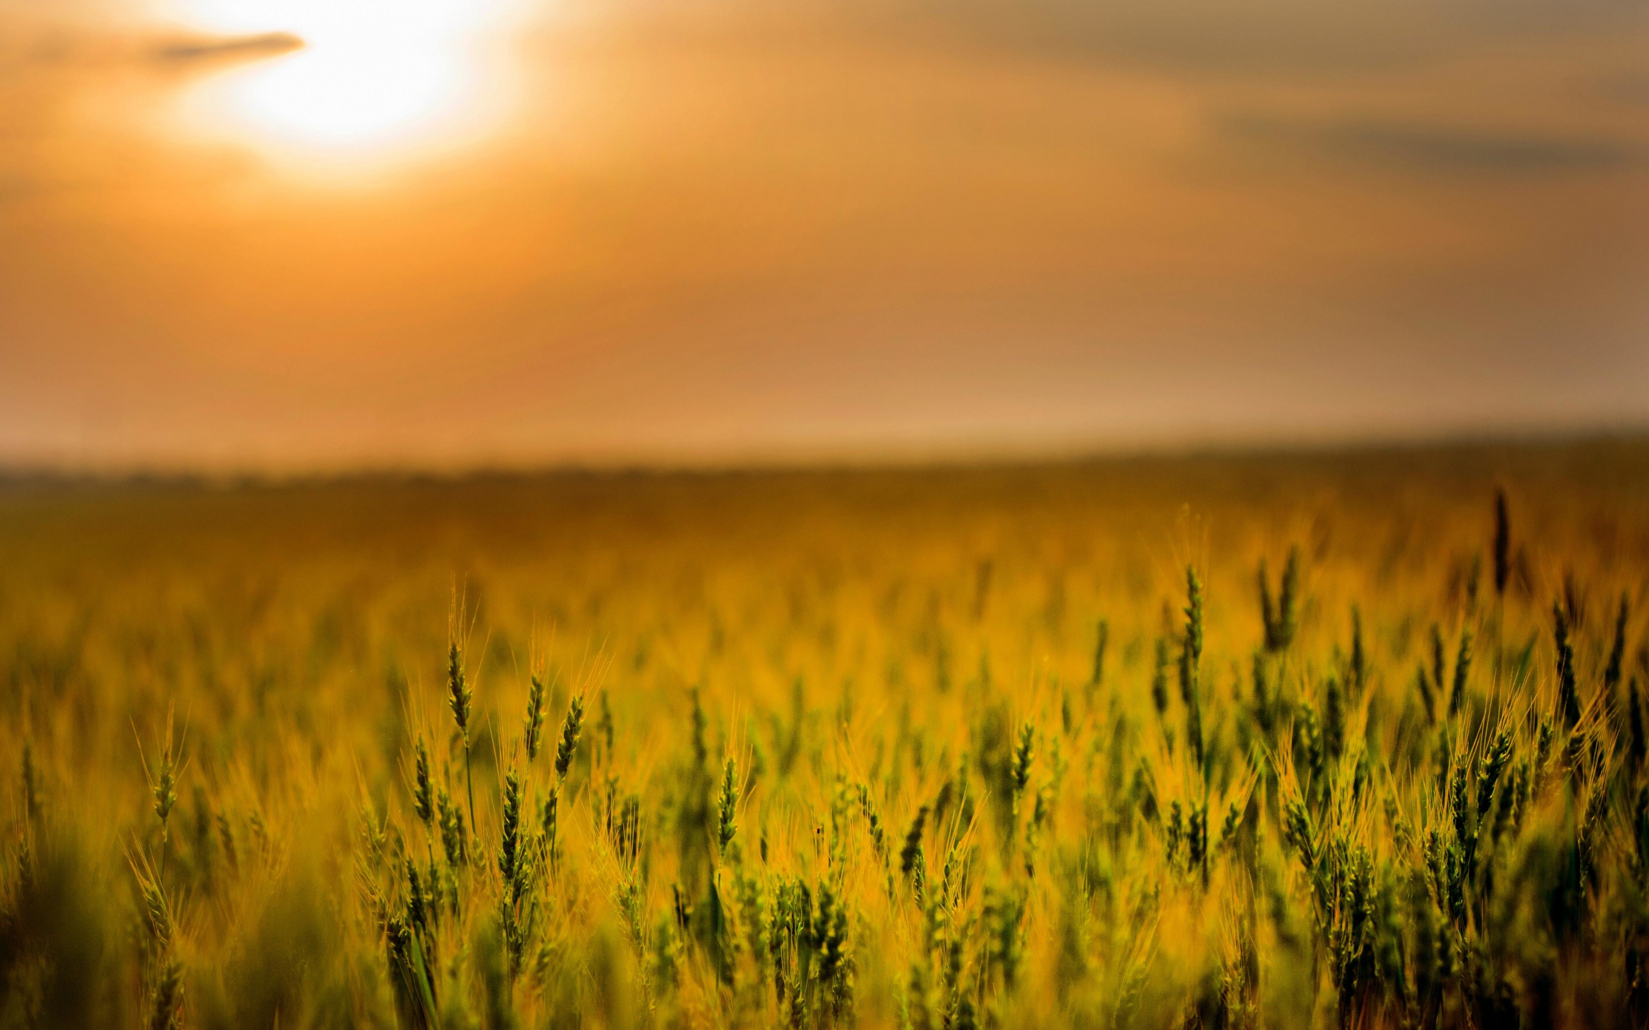
IoT based Smart Agriculture monitoring
G.ARUN KUMAR
B20EC192L

Slide 2
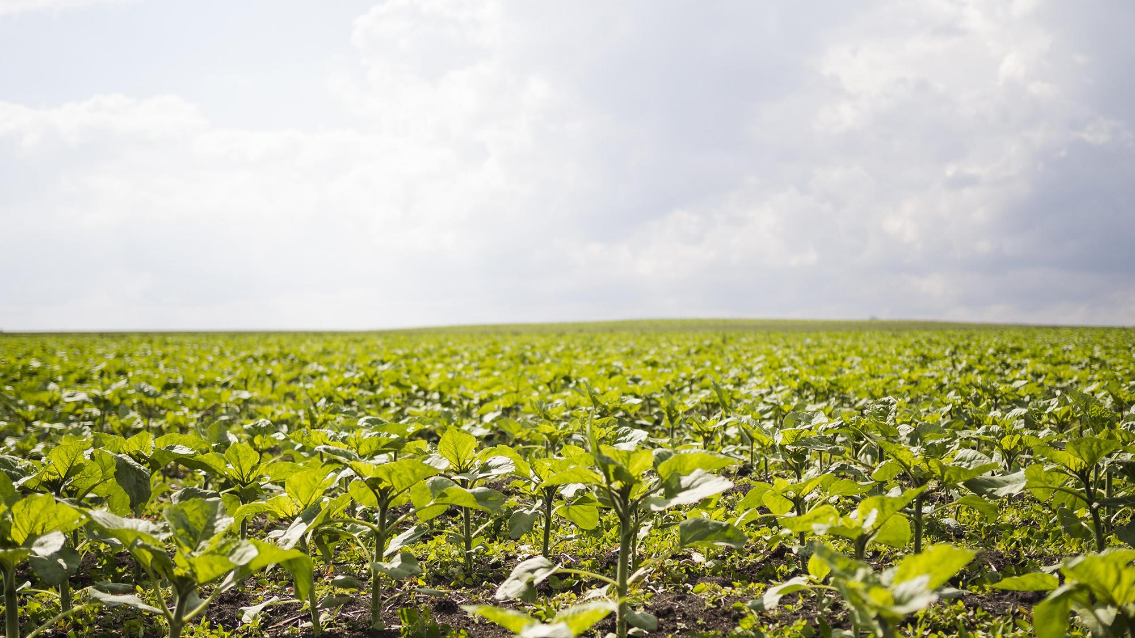
INTRODUCTION
The urgency to prevent environmental degradation, reduce waste and increase profitability, farmers around the globe are increasingly opting for more efficient crop management solutions supported by optimization and controlling technologies derived from the Industrial Internet of Things(IIoT)

Slide 3
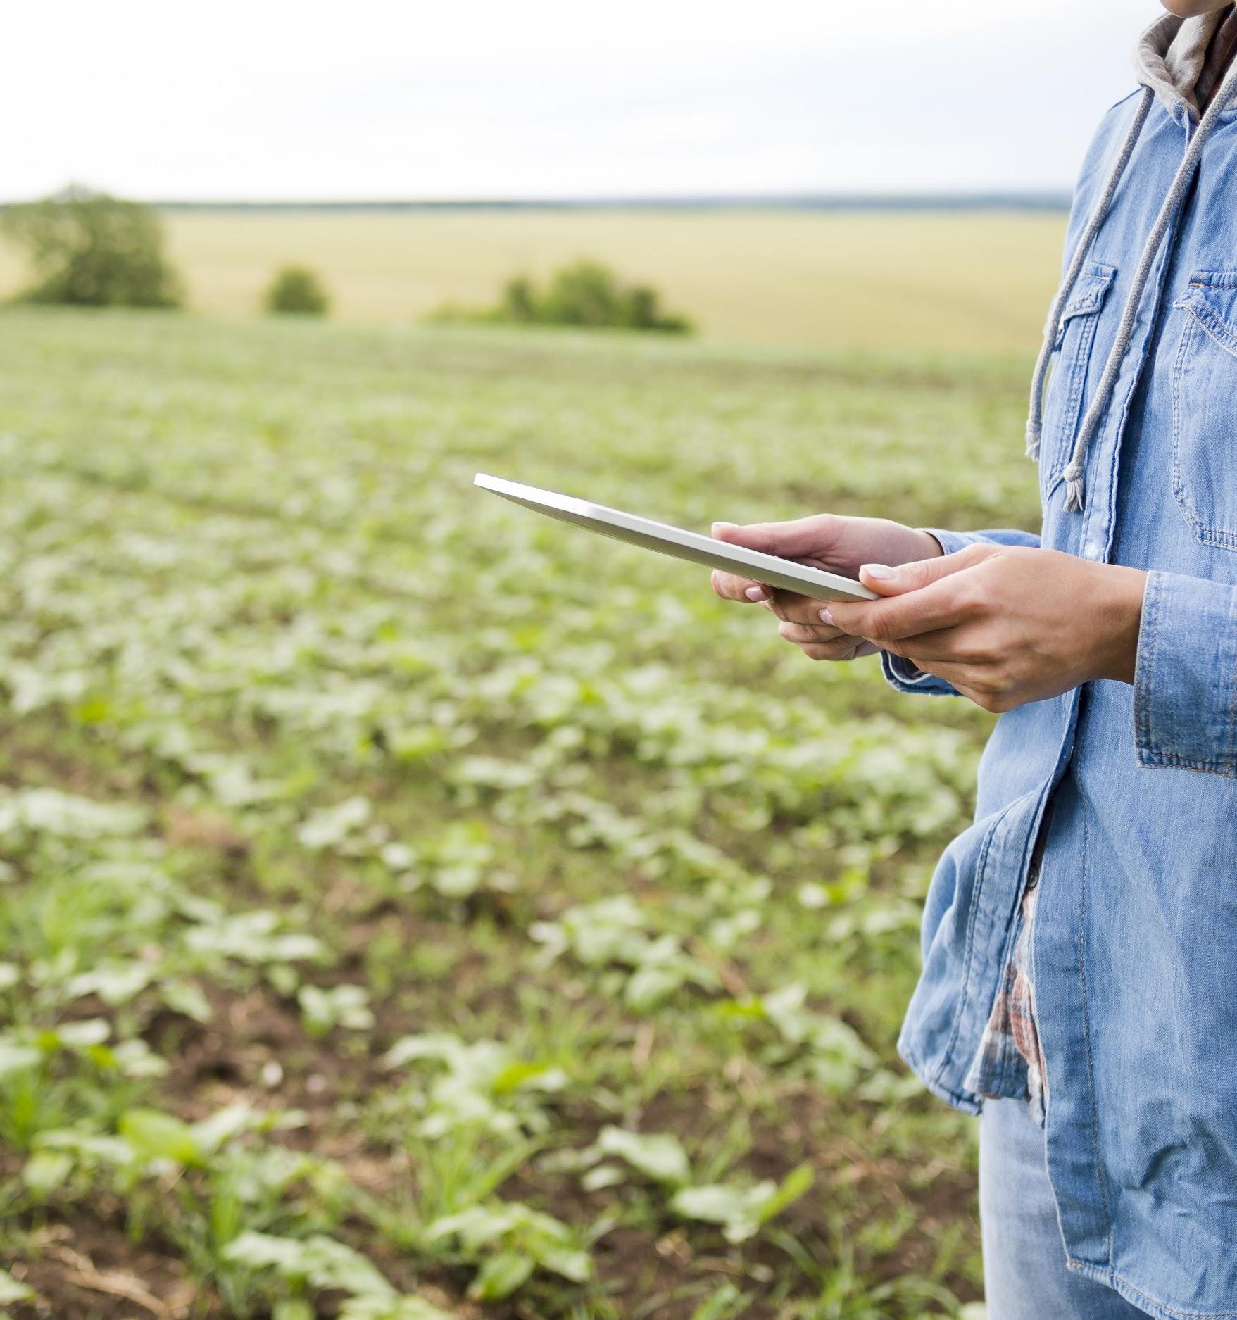
OBJECTIVES
OBJECTIVE
The main objective of this IoT based smart agriculture is to monitor and control the farm parameters like temperature, moisture and humidity
The parameters of the soil can be monitored and analyzed

Slide 4
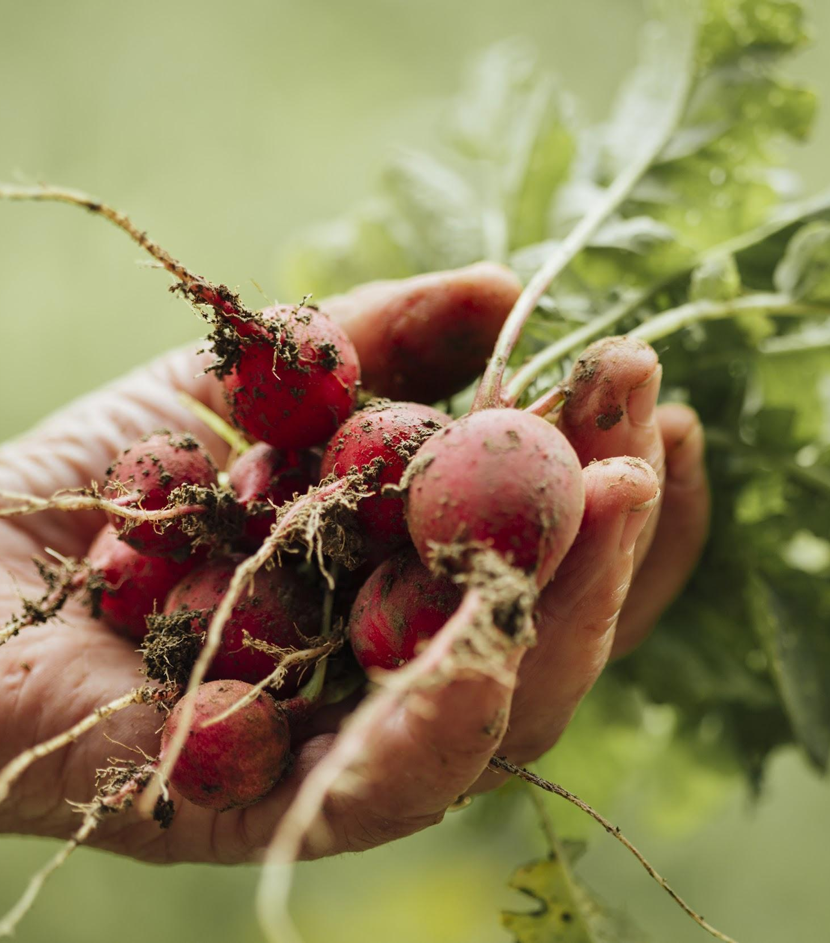
WORKING
The inputs for the Node MCU are taken from sensors
The values from the sensor are will be send to the end user
When the parameters from the sensor goes low it automatically turn on the water pump
Values will be displayed on the web server
By observing the values, farmers can analyse the parameters like temperature, moisture content, humidity

Slide 5
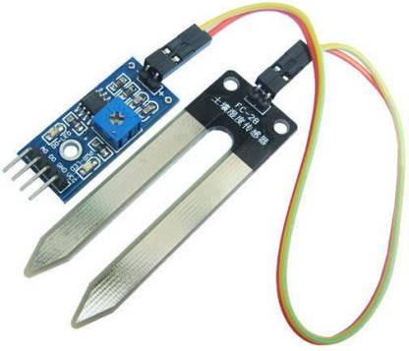
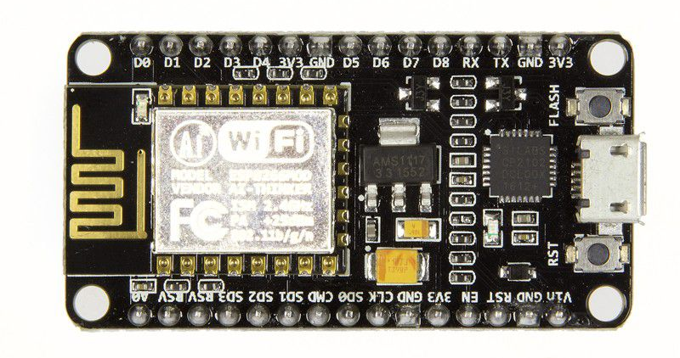
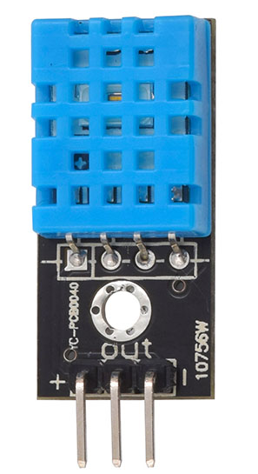
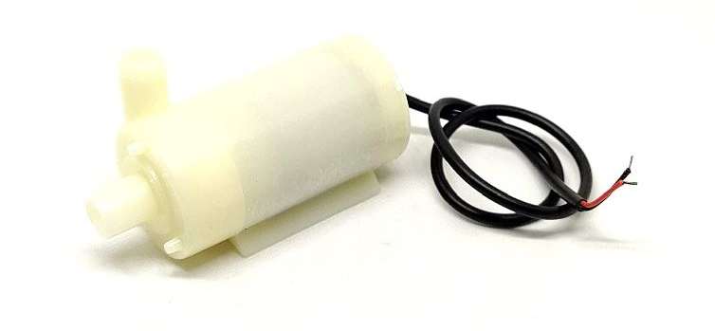
COMPONENTS
1. Node MCU
3. DHT-11
2. Soil Moisture sensor
4. Water pump

Slide 6
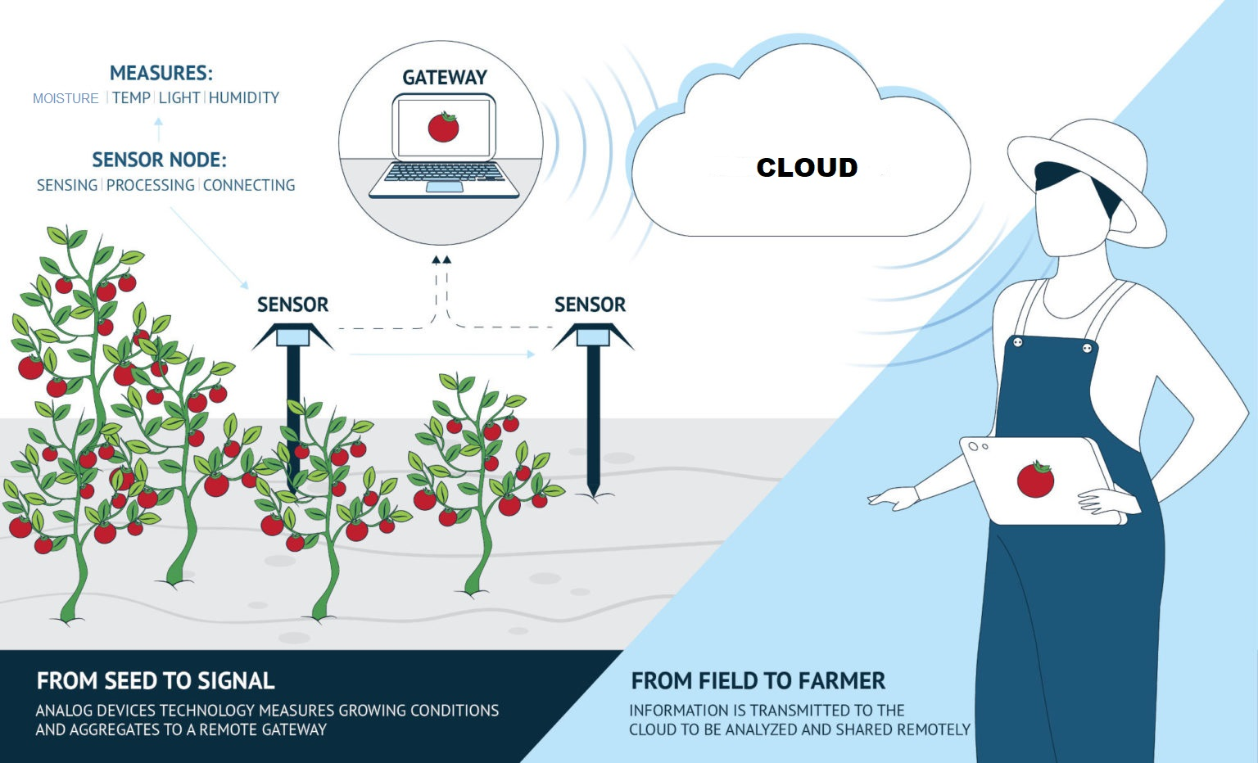

Slide 7
BLOCK DIAGRAM
Moisture sensor
CLOUD
Temperature
sensor
Node MCU
USER
Water pump
Humidity
sensor

Slide 8
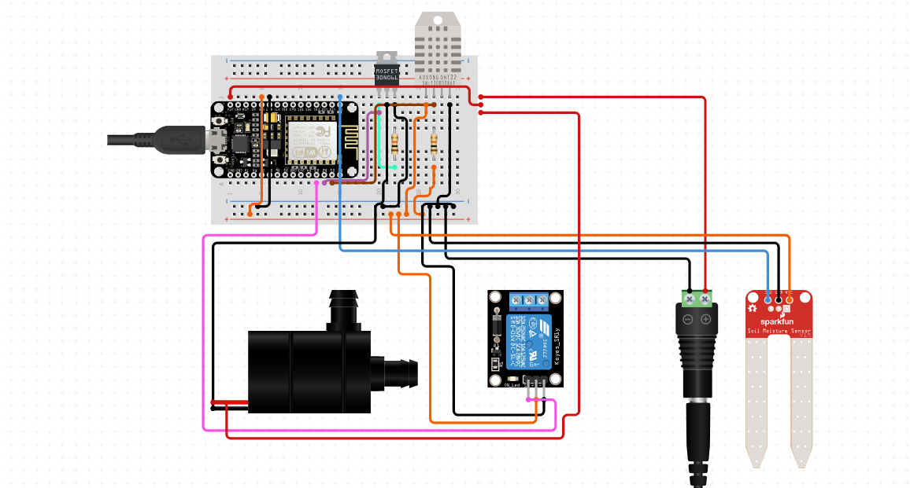
CIRCUIT DIAGRAM

Slide 9
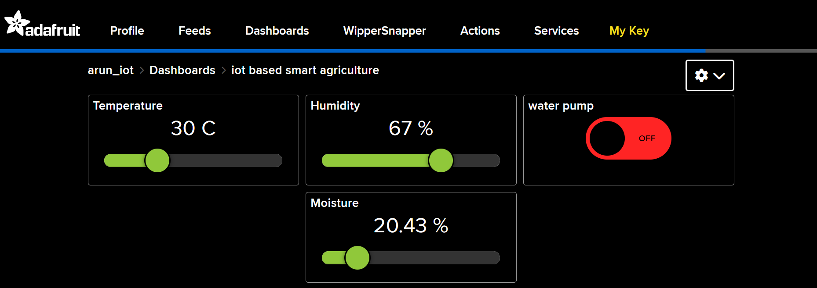
ONLINE DASHBOARD

Slide 10
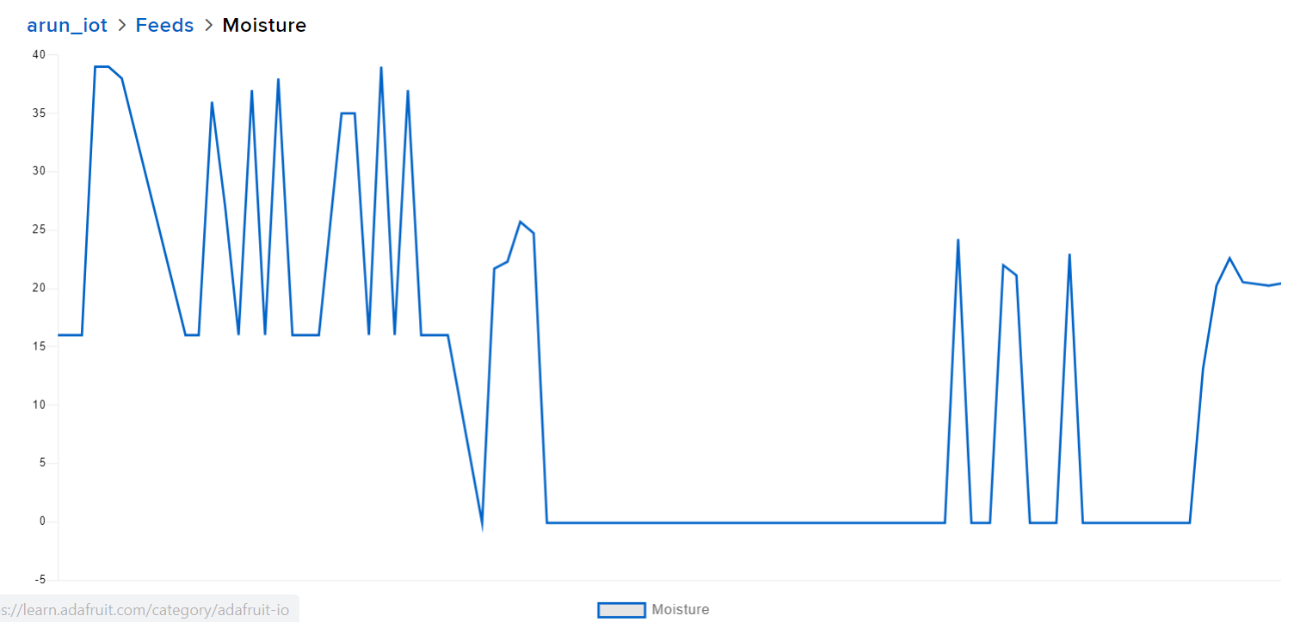
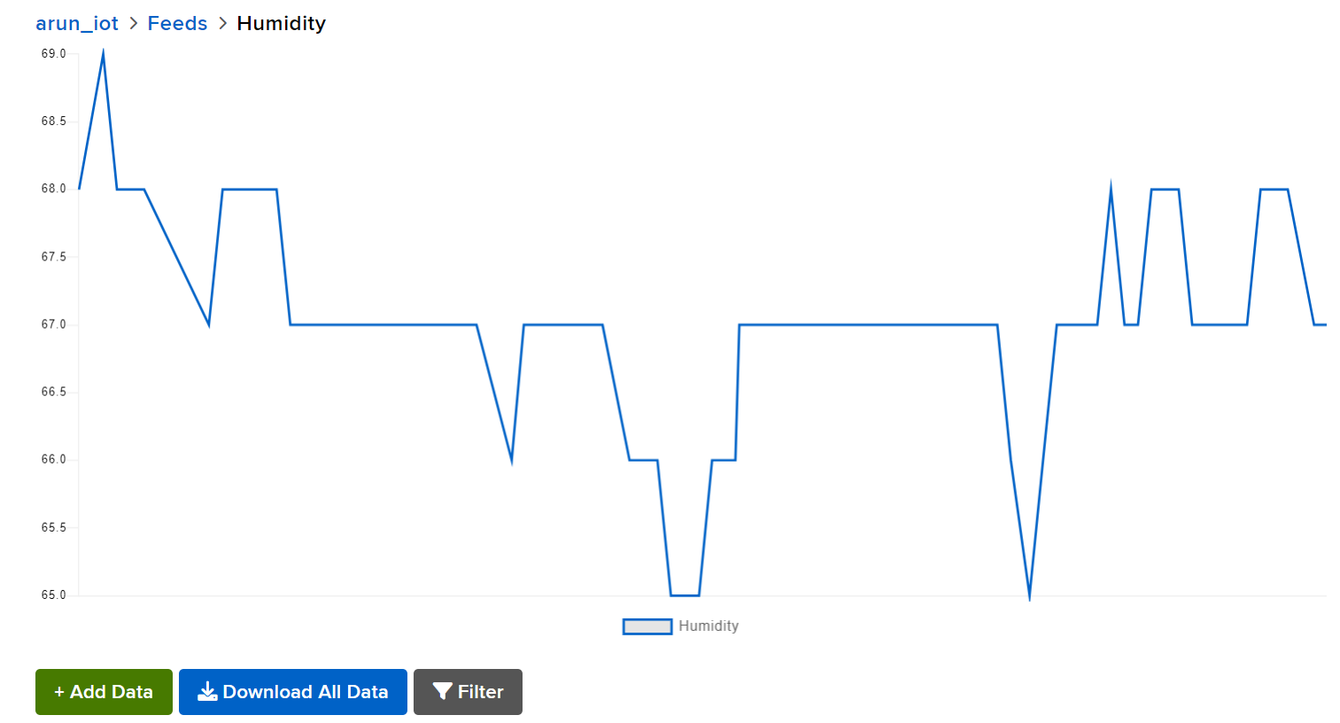
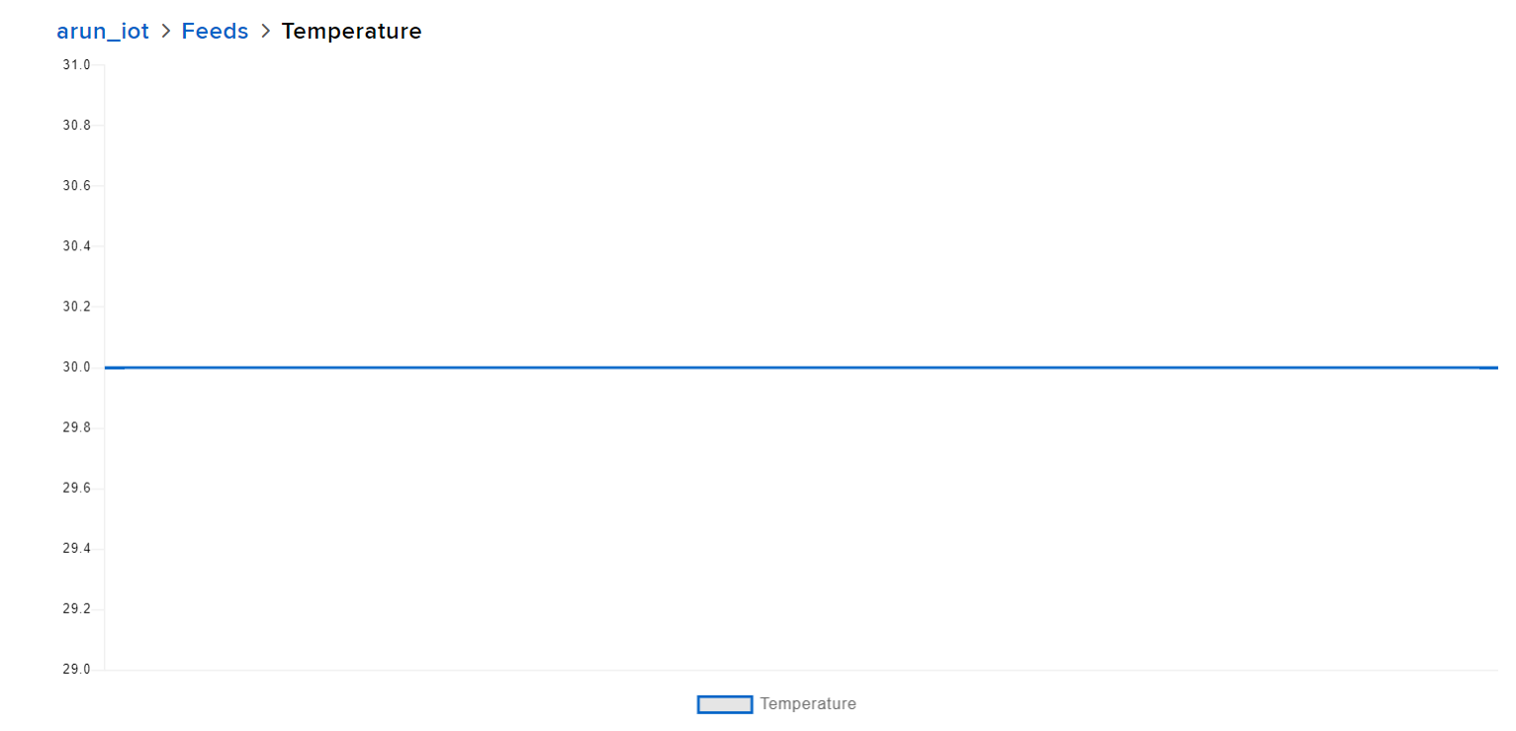
GRAPHICAL
REPRESENTATIONAL OF SENSOR DATA

Slide 11
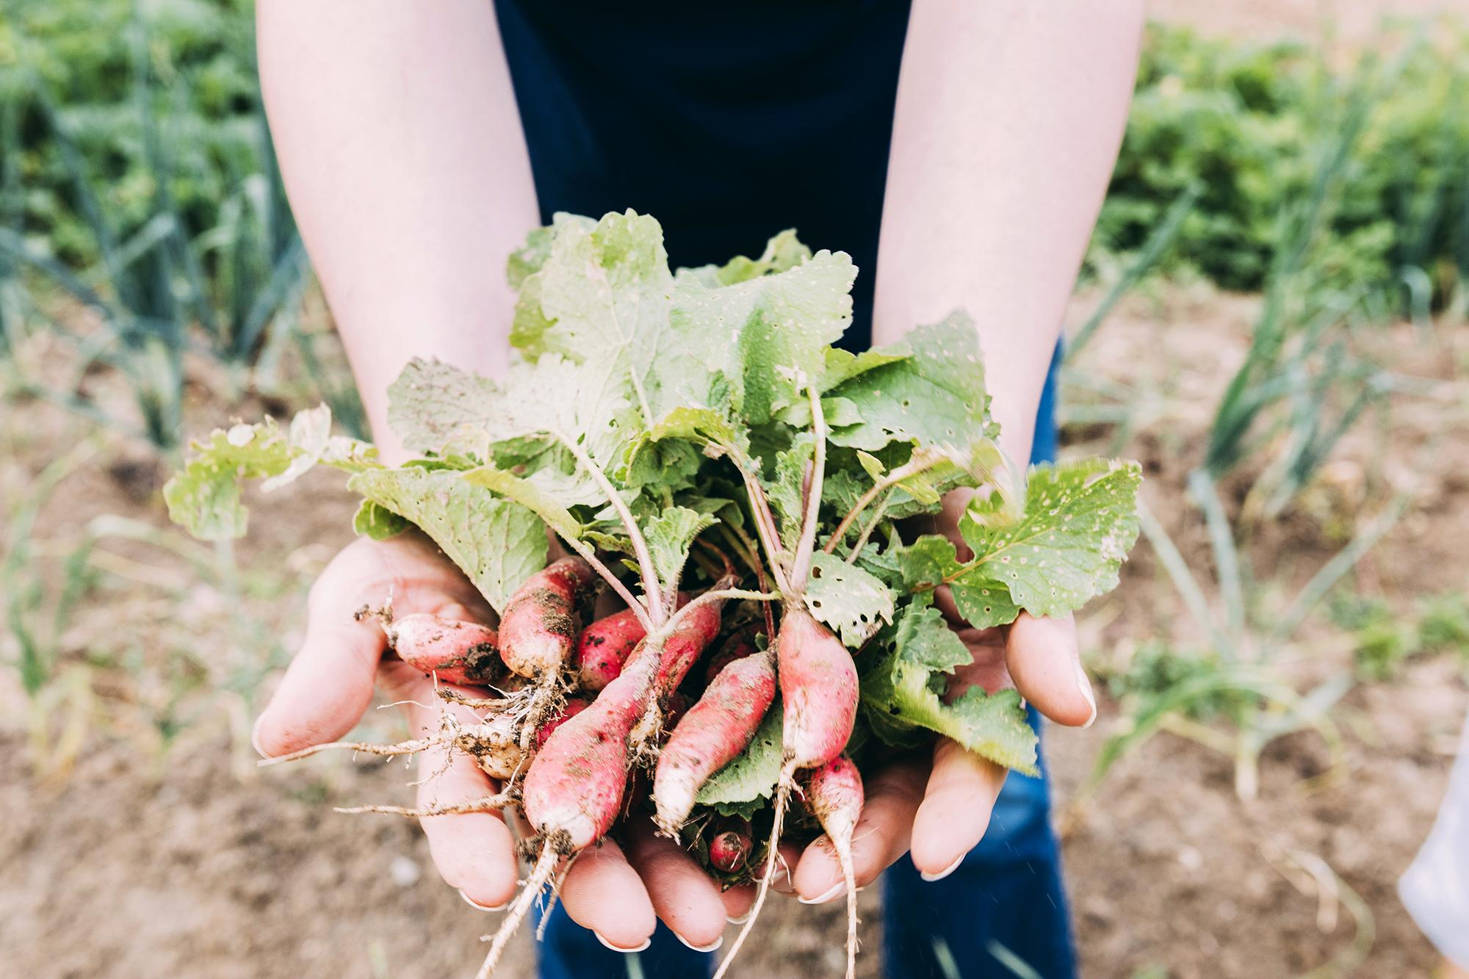
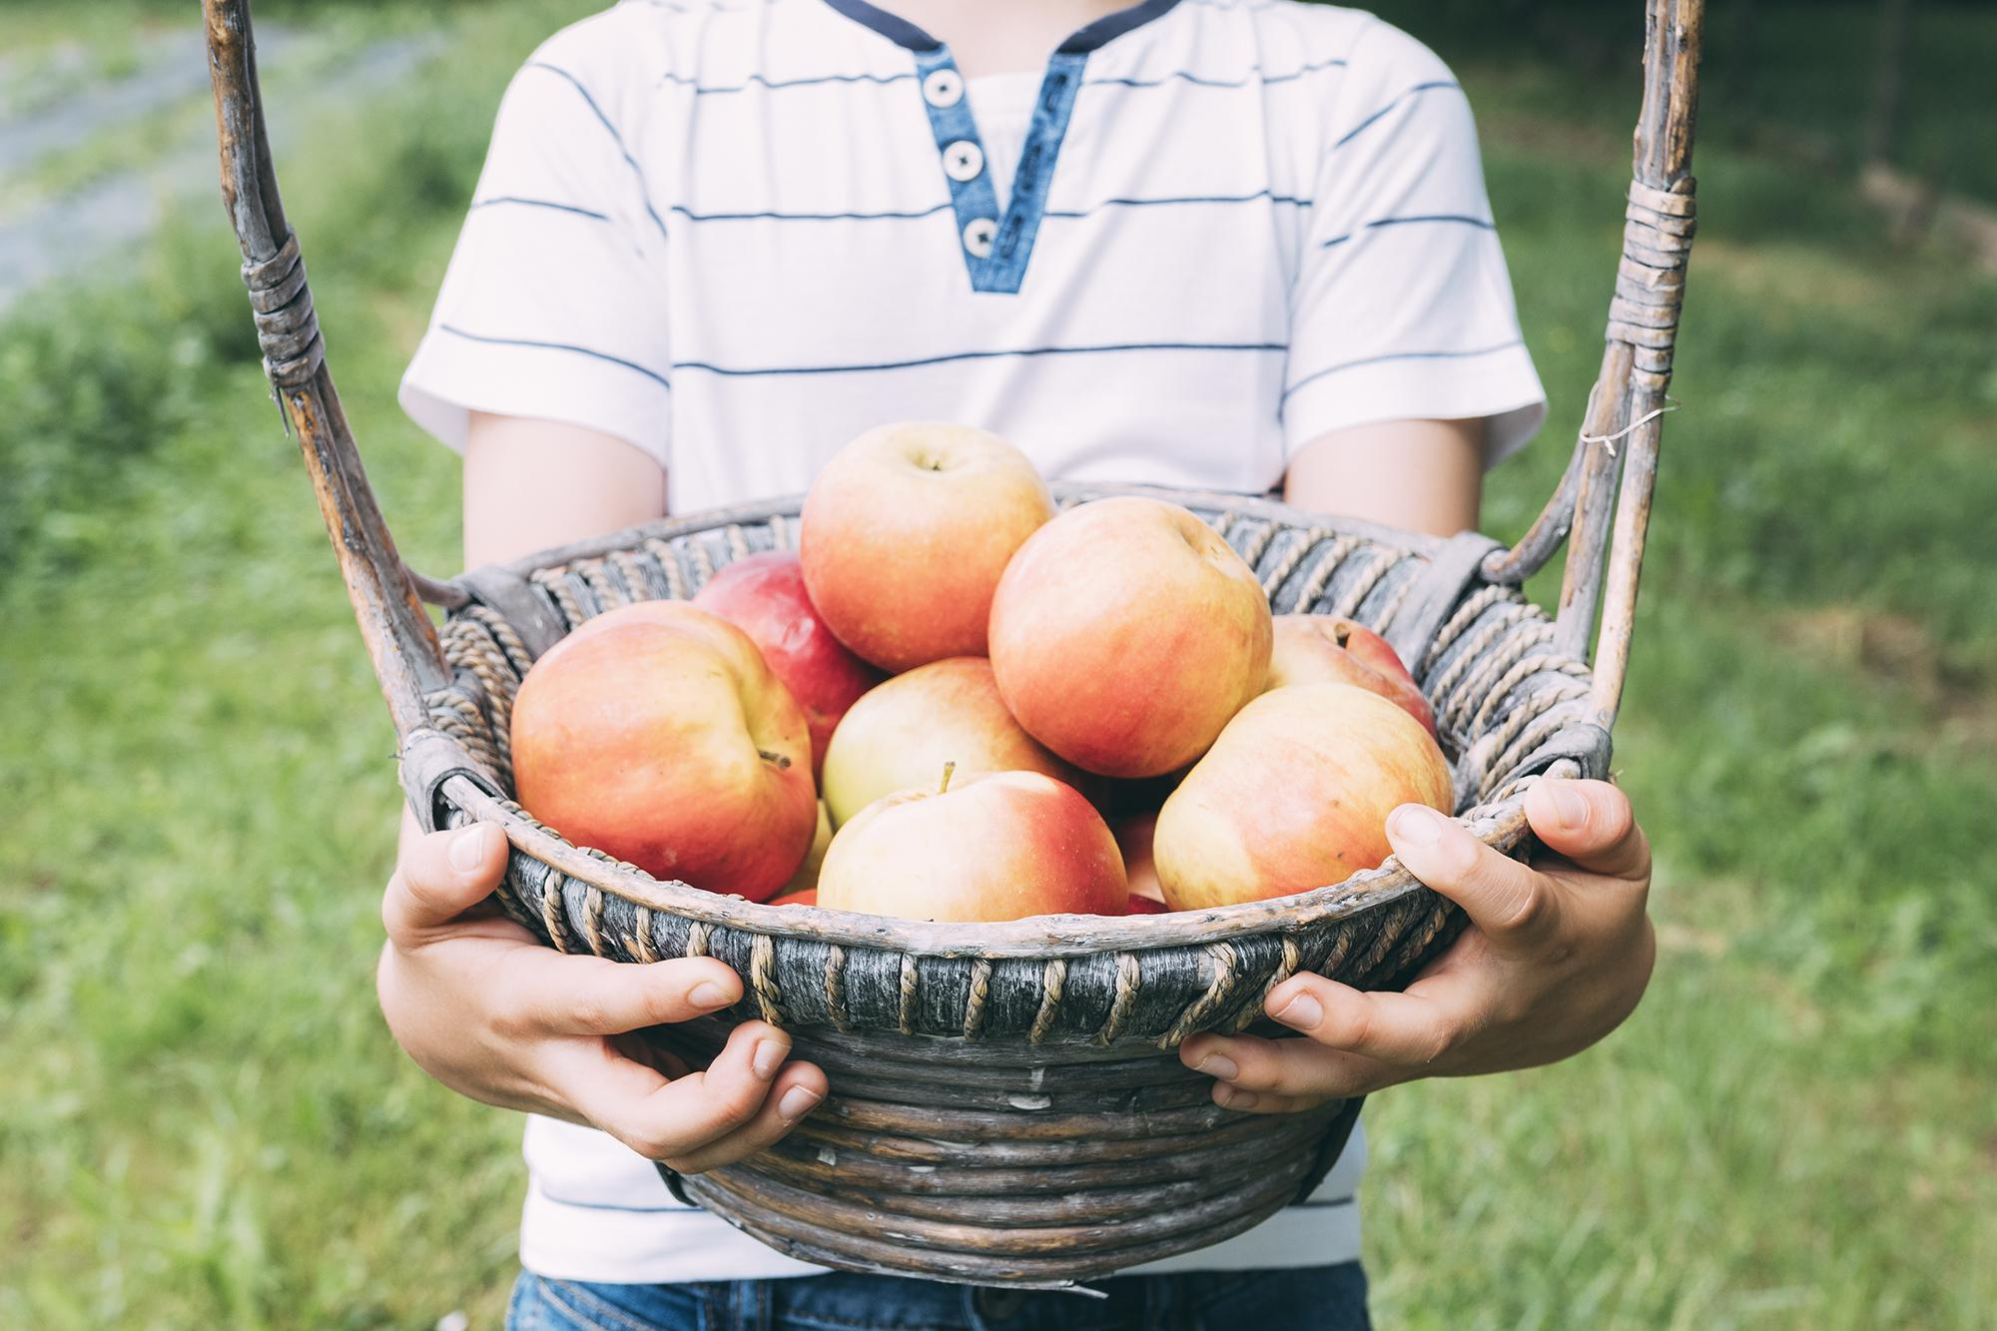
Advantages
Disadvantages
Automates the work of the field.
Provides the farmer with information about his work in the palm of his hand.
Avoids loss of crops.
It informs us in advance and live the problems of our farms.
Restricted to small area
Some parameters can’t be controlled in outer fields
Without Wi-Fi analysing of sensor data is not possible

Slide 12
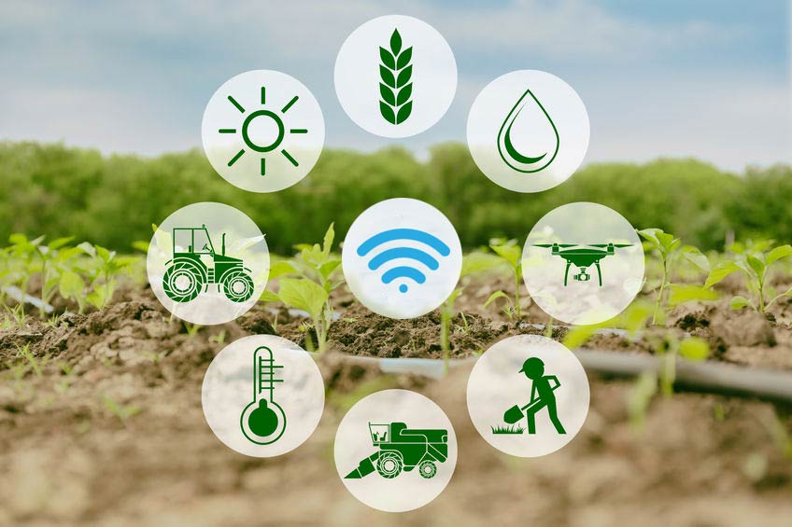
Real time Applications
Can be used for open field and closed(poly house) farms
Used in indoor farming
Used in gardening
Can be used in Agri bots

Slide 13
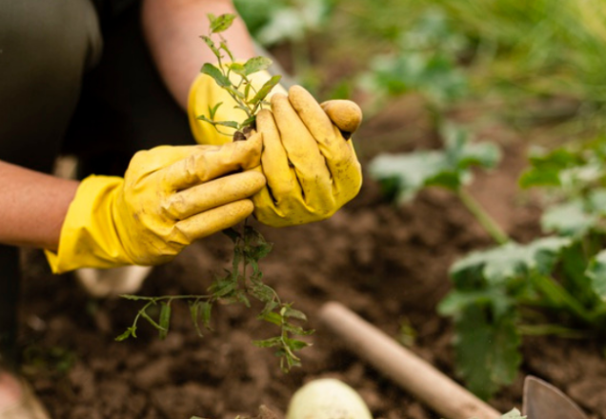
CONCLUSION
Through this system soil condition can be monitored.
content of the soil can be controlled and humidity, temperature and pH can be monitored and analysed

Slide 14
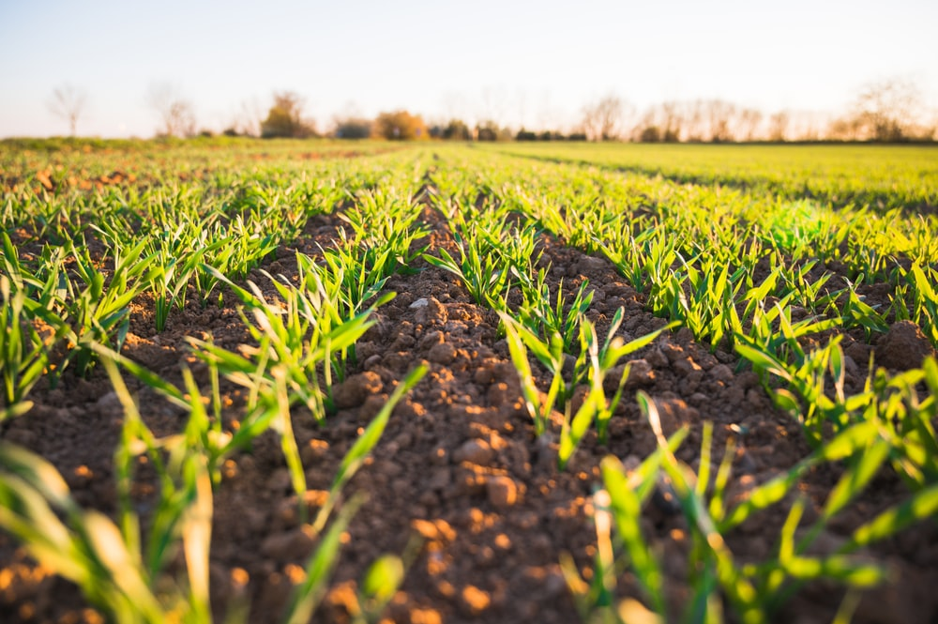
THANK YOU

